Slide 1
METAL DETECTOR USING ROBOTIC VEHICLE
MINI PROJECT
Presented by,
SAMINATHAN G (210419105302)
SRIKANTH K (210419105053)
Guided by,
MR.S.KRISHNAN M.E.,

Slide 2
OBJECTIVE
The main objective of our project is to build a robotic vehicle that can sense metals ahead of it.
To search interesting stuff from where people are not able to reach
To provide safety to the bomb disposal squad.

Slide 3
INTRODUCTION
Metal detector is a device that can detect metal , the basics can make a sound when it is near some metal.
Metal detectors work on the principle of transmitting a magnetic field and analyzing a return signal from the target and environment.
When some metals are coming close to the coil the amplitude of the reflective pulse is getting little lower and a duration of the pulse a little longer

Slide 4
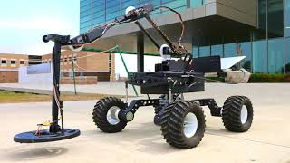
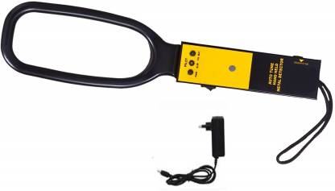
DIFFERENCE
Handheld metal detector
Robotic metal detector

Slide 5
TYPES OF METAL DETECTOR
There are three types of metal detectors
very low frequency(VLF) detectors
pulse induction (Pi) detector
Beat- frequency Oscillation

Slide 6
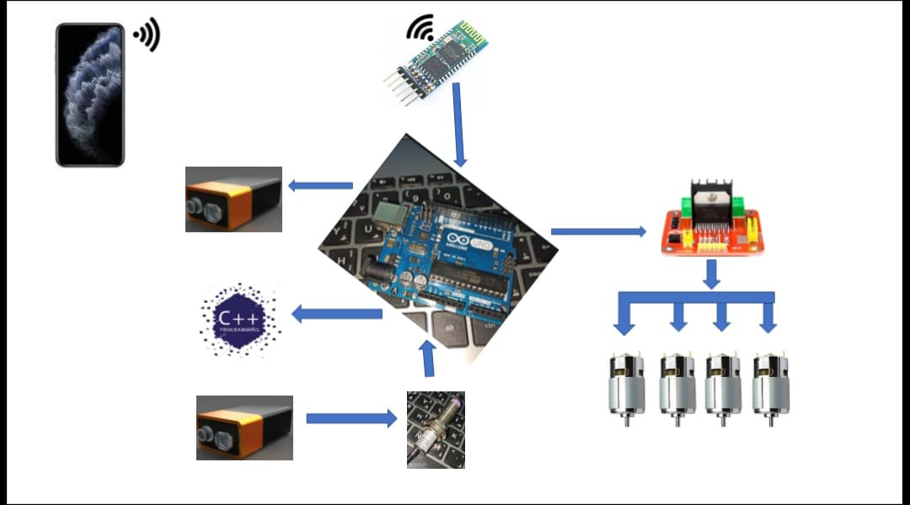
BLOCK DIAGRAM

Slide 7
BLOCK DIAGRAM
Battery
Motor
Arduino
Controller
Bluetooth
L29dn
Metal Detector
Buzzer

Slide 8
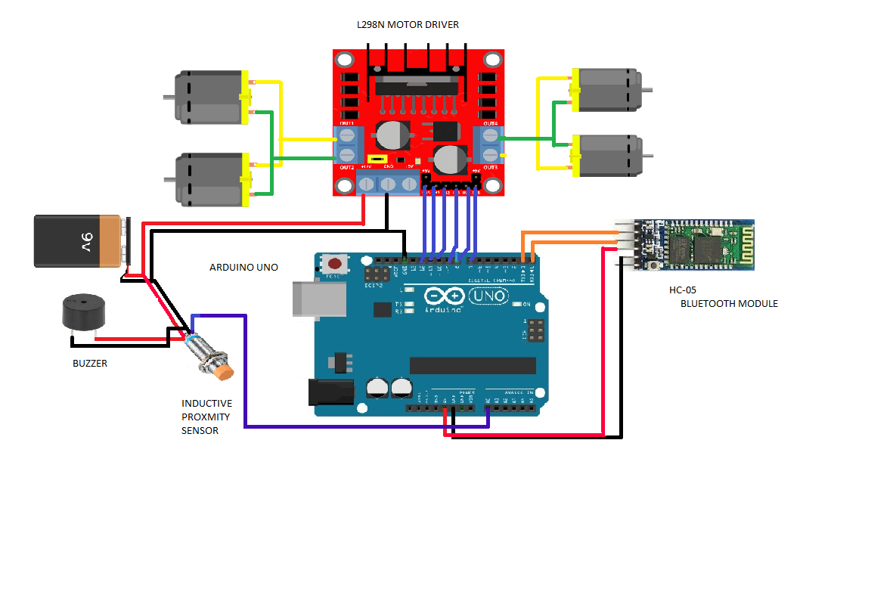
CIRCUIT DIAGRAM

Slide 9


Slide 10
ARDUINO UNO MICROCONTROLLER
Microcontroller - ATmega328
Operating voltage - 5V
Pin Count - 28
Input voltage(recommended) - (7-12)V
Digital I/O pins - 14
Analog input pins - 6
Current per I/O pins - 40mA
Current for 5V pin - 50 mA

Slide 11
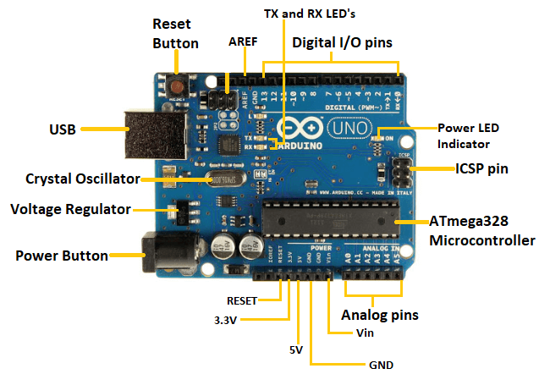
ARDUINO UNO

Slide 12
MOTOR CONTROL DRIVER
Motor Shield is a dual full-bridge driver designed to drive DC motors.
It control the speed and direction of each DC motors independently using the microcontroller.
It uses L298N IC to control the motor.
The Motor Shield is powered only by an external power supply of 5V to 12V.

Slide 13
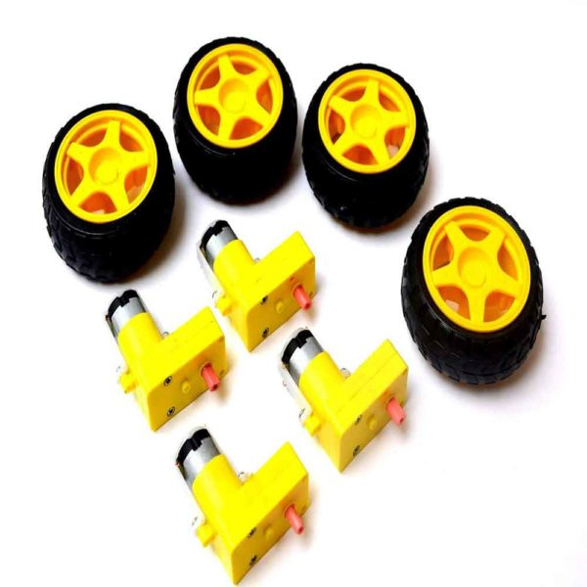
DC MOTOR CONTROL DRIVER

Slide 14
MOTOR DRIVER MODULE L298N
L298N is a H-bridge motor driver integrated circuit (IC).
Motor drivers act as current amplifiers since they are low current control signal and provide high current signal.
This higher current signal is used to drivers the motors.

Slide 15
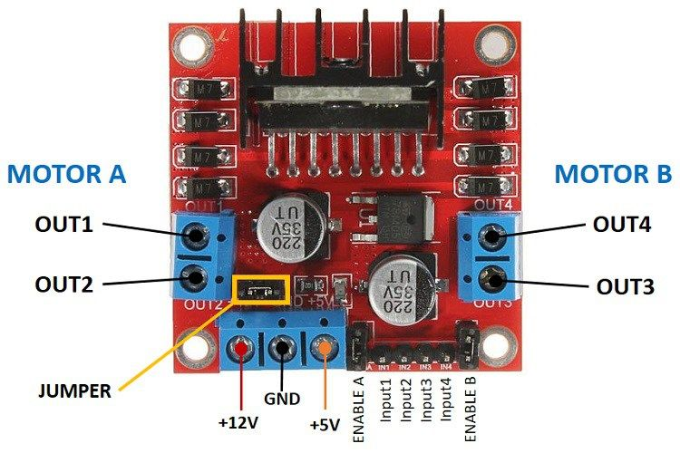
MOTOR DRIVER MODULE L298N

Slide 16
BLUETOOTH MODULE
The HC-05 is a popular module which can use this module to communicate between two microcontrollers like Arduino or communicate with any device with Bluetooth functionality like a Phone or Laptop.
The module communicates with the help of USART at 9600 baud rate hence it is easy to interface with any microcontroller that supports USAR.
It is very easy to pair the HC-05 module with microcontrollers because it operates using the Serial Port Protocol (SPP). Simply power the module with +5V and connect the Rx pin of the module to the Tx of MCU and Tx pin of module to Rx

Slide 17
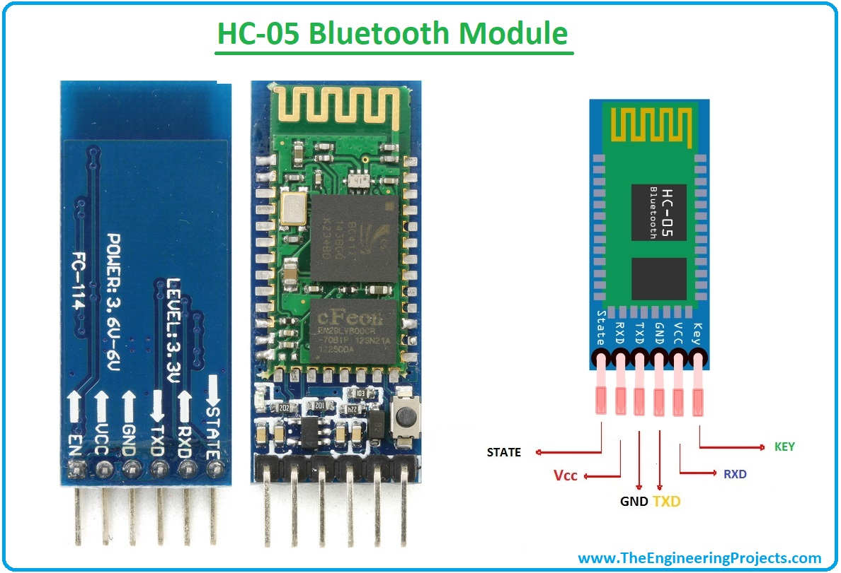

Slide 18
INDUCTIVE TYPE PROXIMITY SENSOR
This sensor operates under the electrical principal of inductance where a fluctuating current induces an electromotive force(EMF) in a target object.
These non-contact proximity sensors detect ferrous targets, ideally mild steel thicker than one milli metre.
They consist of four major components: a ferrite core with coils, an oscillator, a Schmitt trigger, and an output amplifier.

Slide 19
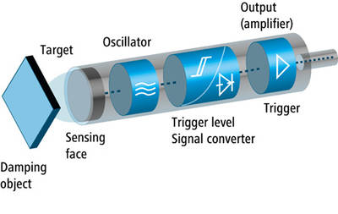
INDUCTIVE TYPE PROXIMITY SENSOR

Slide 20

INDUCTIVE TYPE PROXIMITY SENSOR

Slide 21
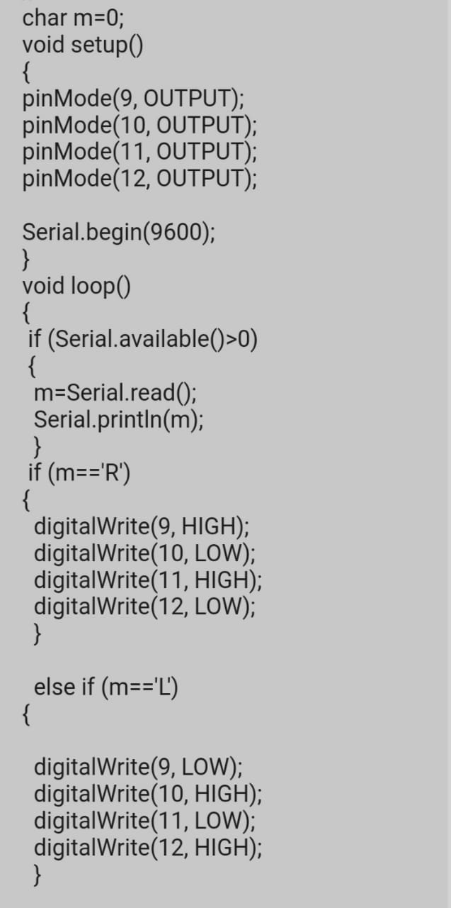
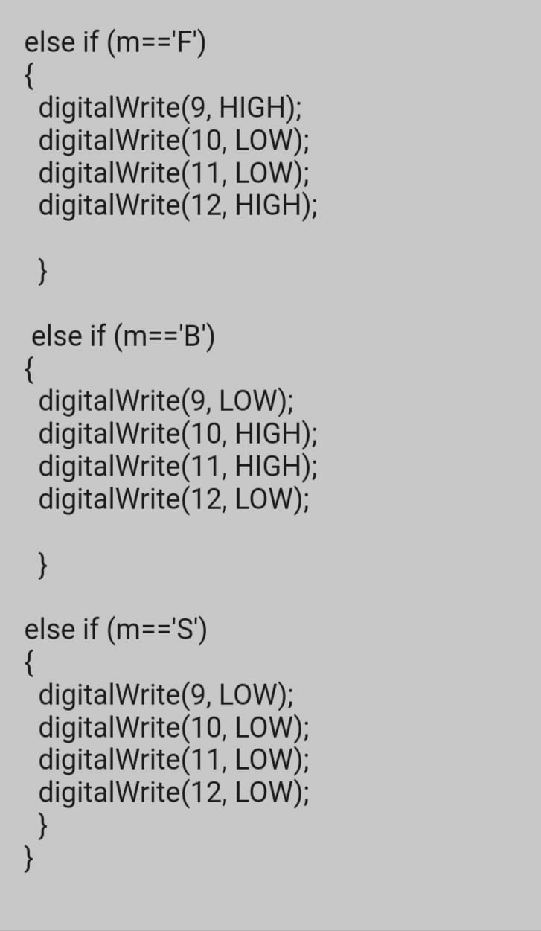
PROGRAM

Slide 22
ALGORITHM
STEP-1 : Start
STEP-2 ; Design the project module
STEP-3 : Upload the commands to Arduino uno
through Arduino Id software
STEP-4 : Switch on the power supply
STEP-5 : Control the system through Bluetooth
mobile controlled Arduino software
STEP-6: Select RIGHT, LEFT, FORWARD, BACKWARD
arrows for moving the vehicle
STEP-7: If the sensor senses the metal , buzzer
Creates NOISE
STEP-8: Check and Debugg the errors
STEP-9; Stop

Slide 23
APPLICATION
It is used for search the metal present in the ground.
Archaeology department like treasure hunting for caches of coins, jewellery, weapons, and so on.
There robots are used in detecting landmines.
Consumer related application.

Slide 24
FUTURE ENHANCEMENT
Mounting a wireless camera on the robot
Placing a GPS (Global Positioning System) device on the robot
By increasing the coil size and supplying more voltage we can also use it for finding landmines.

Slide 25
REFERENCE
https://techatronic.com/how-to-m￼￼￼￼￼￼￼￼￼￼￼￼￼￼￼￼￼￼￼￼￼￼￼￼￼￼￼￼￼
[1] “LC Oscillator Basics” Available:
http//www.electronicshub.org/lc-oscillator-basics/
[2] “Metal Detector – History of Metal Detector” Available:
https://www.softschools.com/inventions/history/metal_detectr
history/376/
[3] “Metal Detector and Scanning”
Available: https://nexussafety.net/metal-detector-scanning/
[4] “How a metal detector works” Available:
https://micro.magnet.fsu.edu/electromag/java/detector/index.html

